Slide 1
EFFECTIVE PROJECTED AREA (EPA)

Slide 2

Objectives
Know the difference between Wind Load and Dead Load
Understand what EPA is and why it’s important
Learn the factors of EPA
Find fixture EPA on spec sheets
Size Valmont poles with adequate EPA requirements

Slide 3
Effective Projected Area (EPA)
Effective Projected Area
Projected Area (PA) multiplied by the drag coefficient (Cd)
Projected Area (PA) of an Object
Length multiplied by Width
Drag Coefficient (Cd)
Shape Factor of the Object

Slide 4
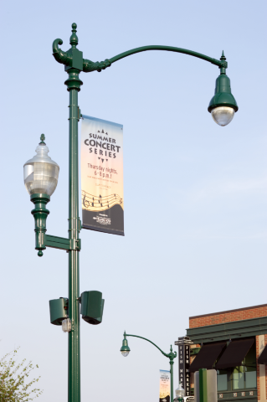
Wind Load and Dead Load
Dead Load acts in the vertical plane while Wind Load acts in the horizontal plane.
Valmont engineering needs the locations, sizes, and weights of all objects to determine the wind load and dead load applied to the structure.
The distance of the load up from the base, and the distance of the load out from the pole, increases the bending moment, so arm length and exact positioning of the load is important for proper analysis.

Slide 5


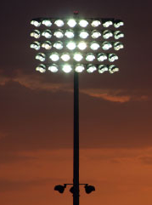
Wind Load
The wind load, is a direct result of the Effective Projected Area (EPA), and is always used in the design of the pole.
When thinking about the wind load, imagine that each object on the pole is a sail from a sailboat. The sails grab and resist wind from passing through, creating more force on the pole.
sail
sail

Slide 6
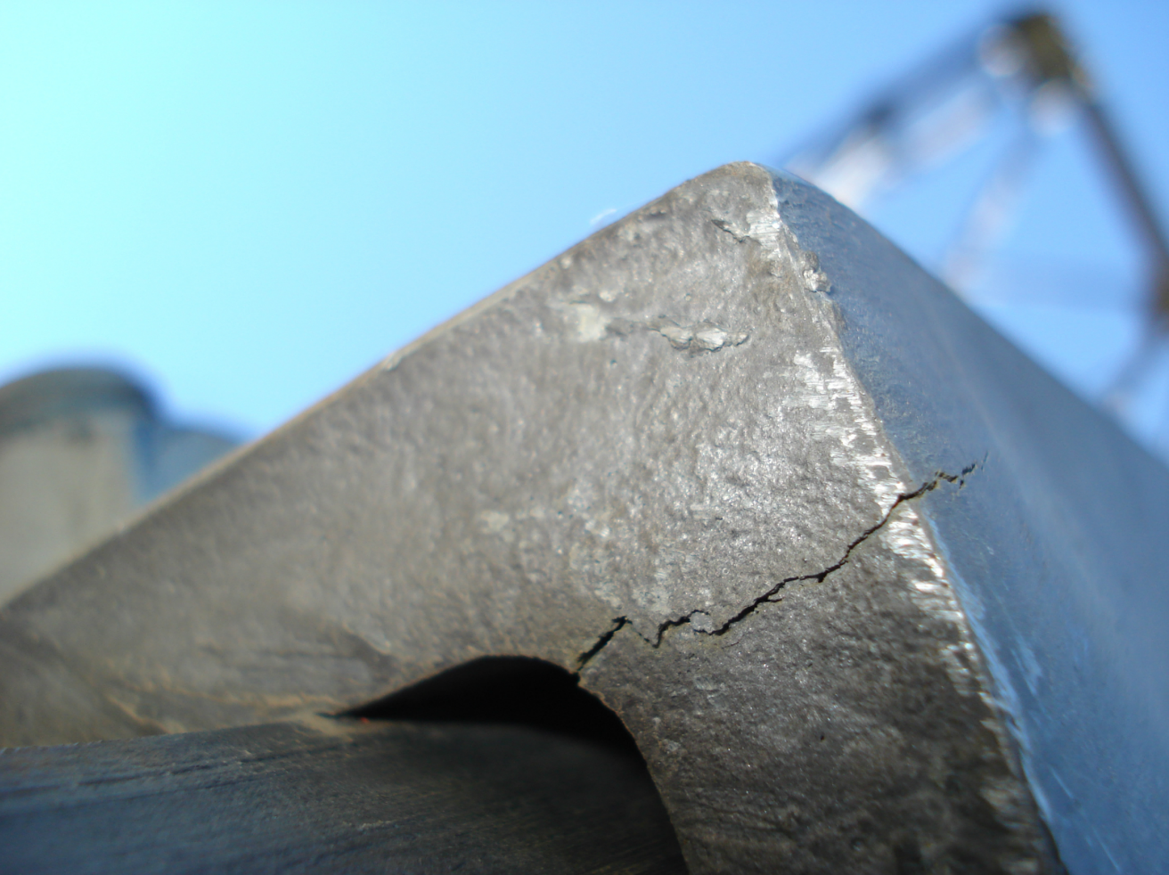
Why EPA is Important
Adding a load with an EPA too large for a pole may cause the pole to fail. Enough wind force may cause steel or aluminum poles to buckle or crack and fail at the welds.
It’s important to follow all EPA guidelines to correctly size a pole. States or customers may require sizing requirements from the American Association of State Highway and Transportation Officials (AASHTO).
AASHTO creates guidelines for highway and construction design throughout the United States.

Slide 7
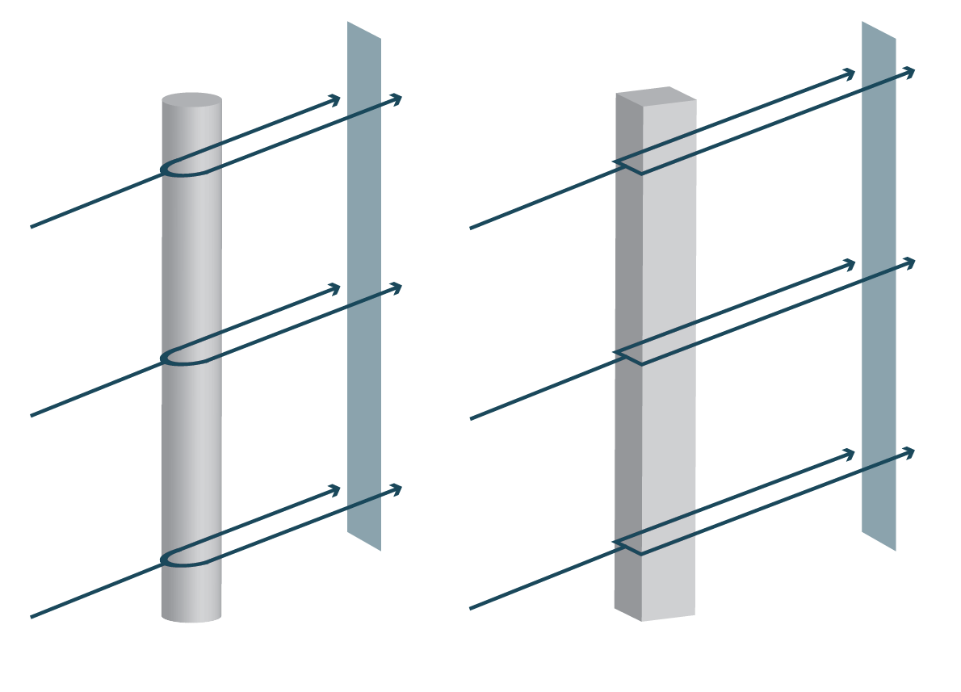
What is Projected Area (PA)?
Projected Area
Projected Area is the measure of a three dimensional object on a two dimensional area, known as the projected area. Since PA is measured in square feet, think of the concept as the object’s shadow.
Engineers use this to identify the wind resistance and force on objects, and their ability to structurally support themselves and their load.

Slide 8
Factors of EPA
Drag
Projected Area
The Effective Projected Area contains two parts:
Drag Coefficient (Object)
The Projected Area
The shape of the object will vary the drag coefficient. The drag coefficient is a calculated multiplier based on the amount of resistance the object has. Any object that will be mounted on the pole will need to be measured.

Slide 9
Common Drag Coefficients (Cd)
Drag
Projected Area
Pole Drag Coefficients
Round Pole: 0.45 – 1.10
Square Pole: 1.25 – 1.90
Luminaire Drag Coefficients
Rounded Luminaire: 0.5
Flat Luminaire: 1.2
Sign Drag Coefficients: 1.12 – 1.30
Banner Drag Coefficient: 1.45
Traffic Signal Drag Coefficient: 1.20

Slide 10
Shape Effects EPA
For example, according to AASHTO, a rectangular flat shape will create around 60% more resistance than a round object.
Because of this, the correct loading weight and EPA must be known before sizing or selecting a pole.

Slide 11
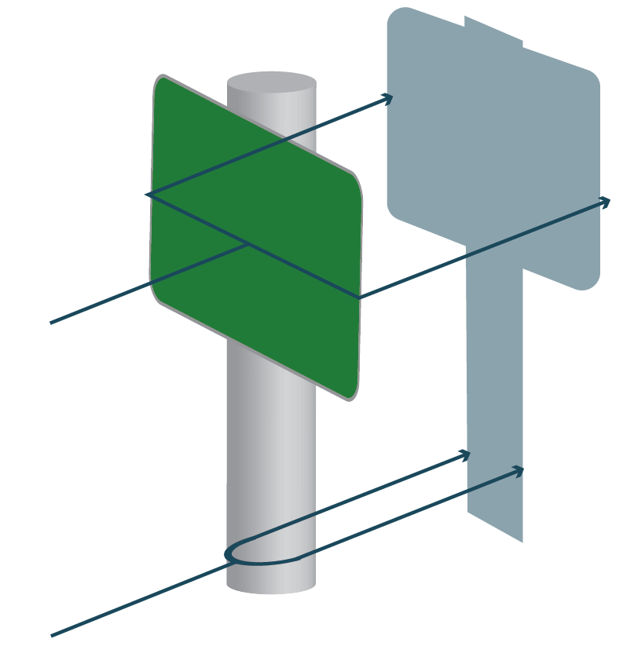
EPA Effects Structure Size
Low EPA
High EPA
higher drag coefficient = larger EPA = more resistance = larger structure

Slide 12
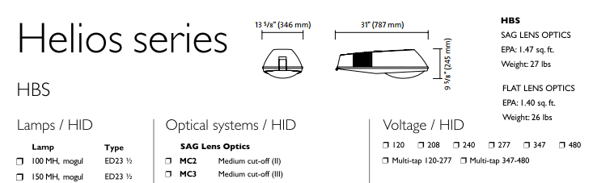
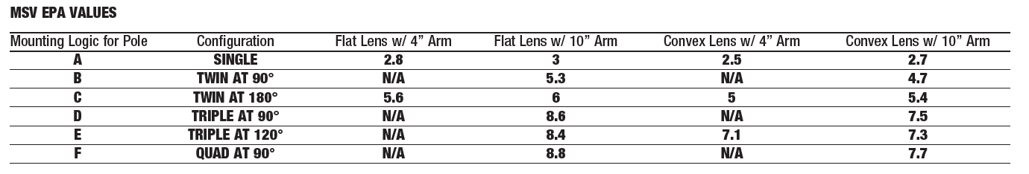
Pole Size Requirements - Fixture
The EPA of a fixture or fixture cluster should be provided by the manufacturer on the product spec sheet.
If the EPA is not clearly stated, reach out to the manufacturer before sizing the pole.
1.47 sq. ft.
1.4 sq. ft.
Philips Cobra Head
Cluster EPA values: Spaulding MSV Series

Slide 13
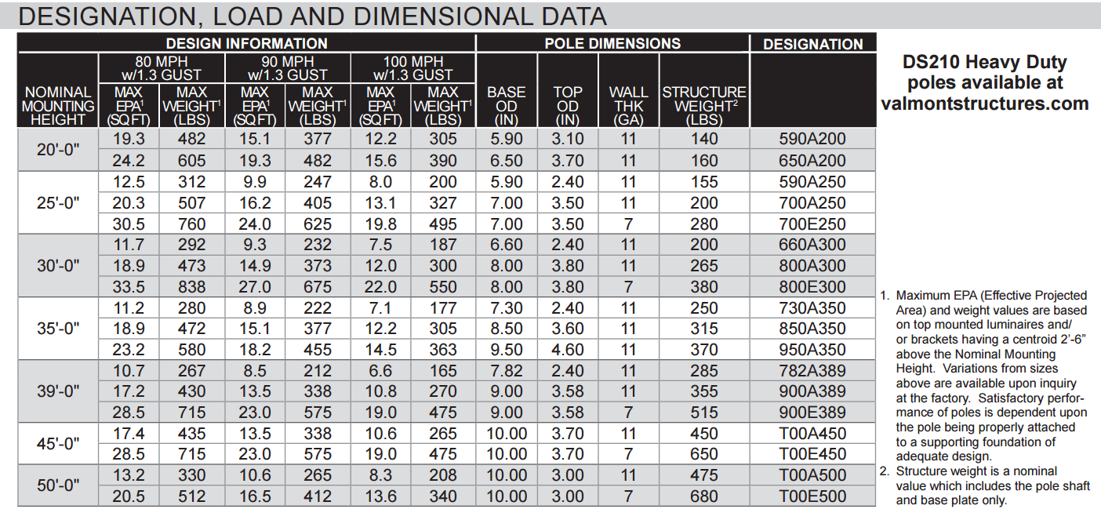
Pole Size Requirements
Engineering will calculate the EPA for your fixture, traffic signals, trussing, banners, or other attachments, and find a pole that can meet your needs.
Keep in mind the wind requirements designated by the state or customer (ex: Florida has higher wind requirements).
Footnotes will say where the load is calculated.
*DS210 shown above

Slide 14

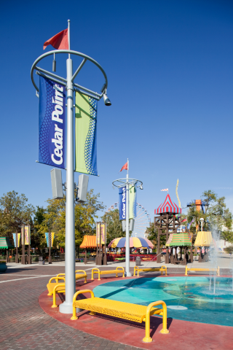
Pole Size Requirements – Custom Design
If you are unable to find a pole that fits your EPA and loading needs, contact your Valmont RSM or PA.
Valmont continually provides designs and quotes for custom applications.

Slide 15
THANK YOU!
valmontstructures.com

